Slide 1

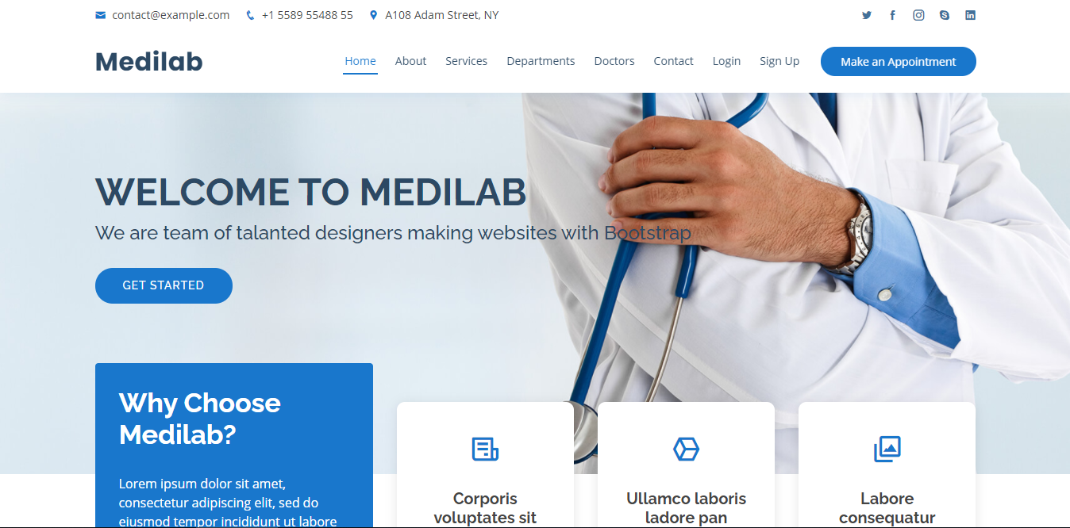
Java Realtime Project-Fullstack Development
-by Narsi

Slide 2
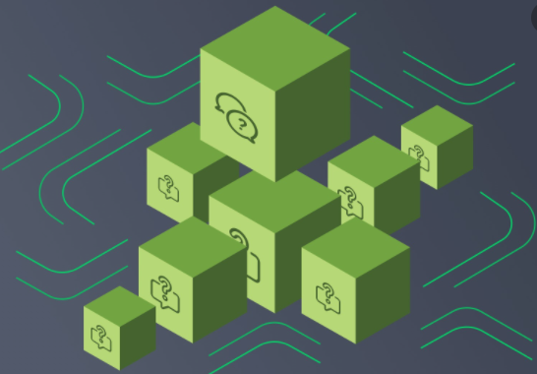
Content-Agenda
01
Decomposition Patterns
02
Integration Patterns
03
Database Patterns
04
Event Driven Patterns
05
Observability Patterns
06
Cross Cutting Concern Patterns
07
ResilienceJ Patterns

Slide 3
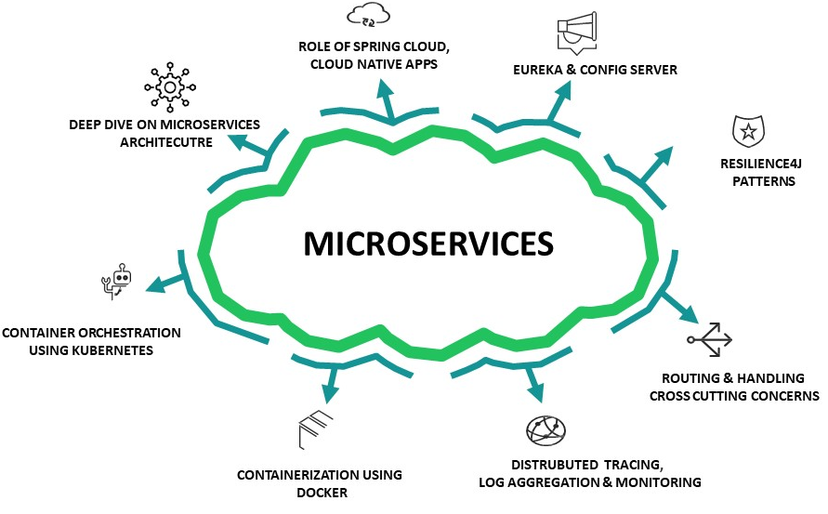

Slide 4
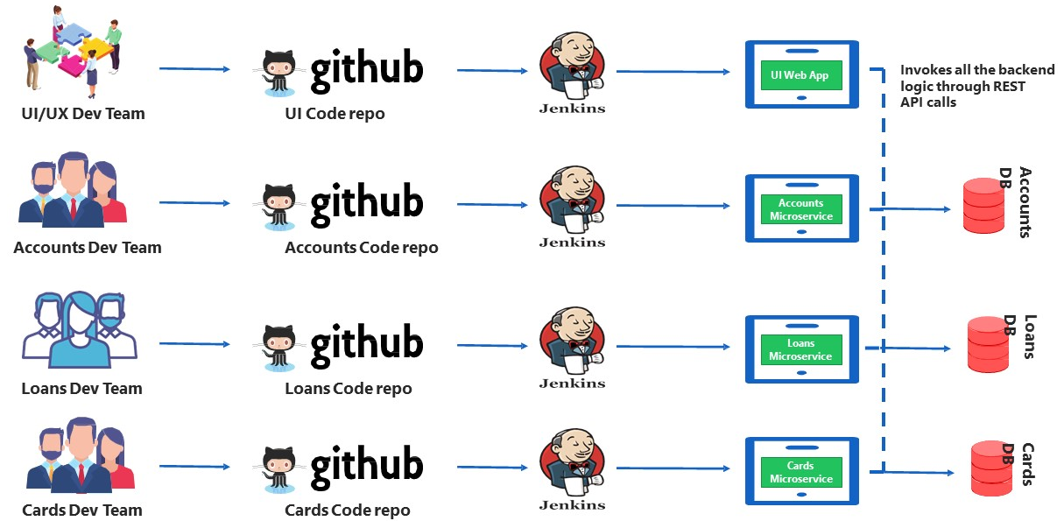

Slide 5
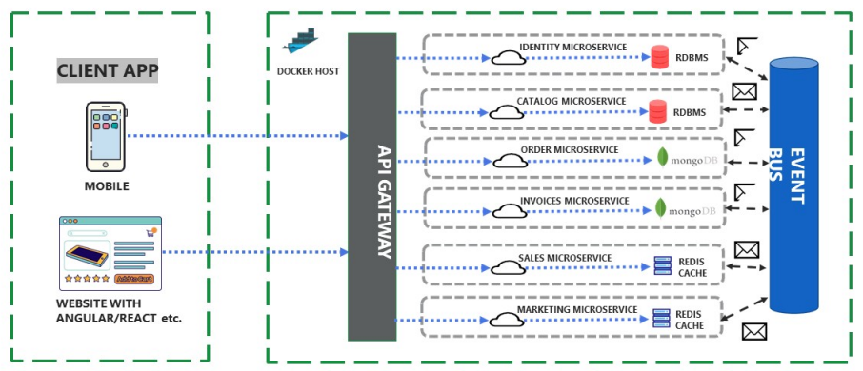

Slide 6

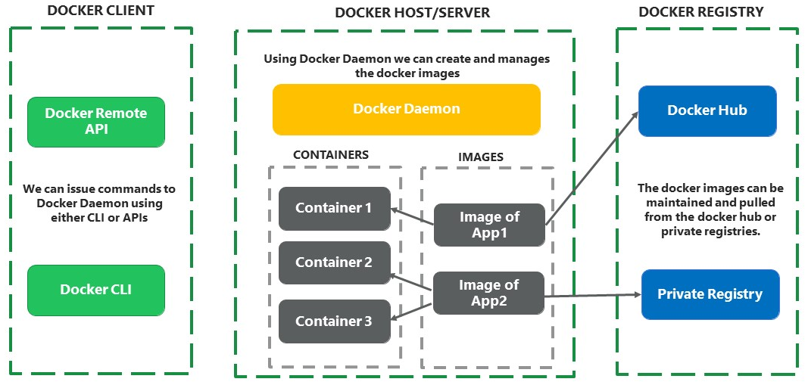

Slide 7
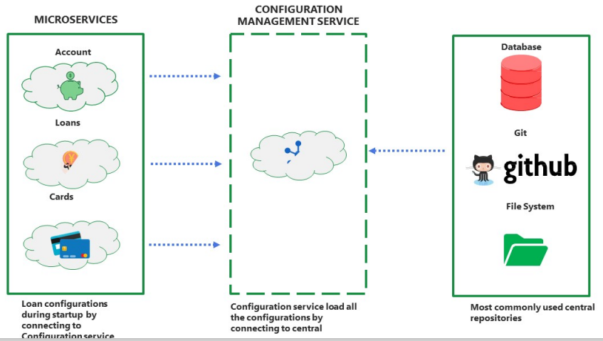

Slide 8
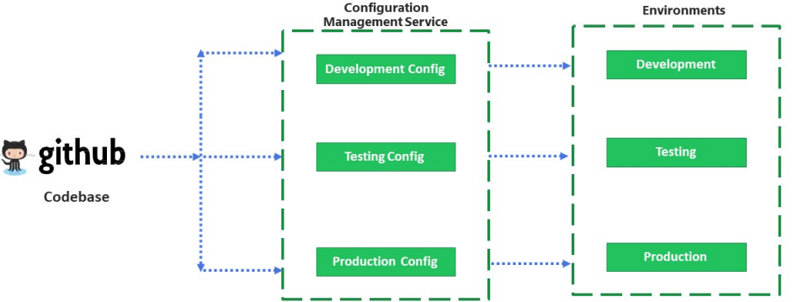

Slide 9
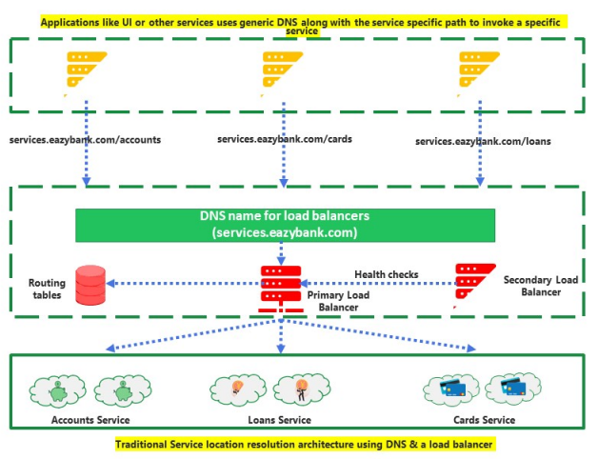

Slide 10
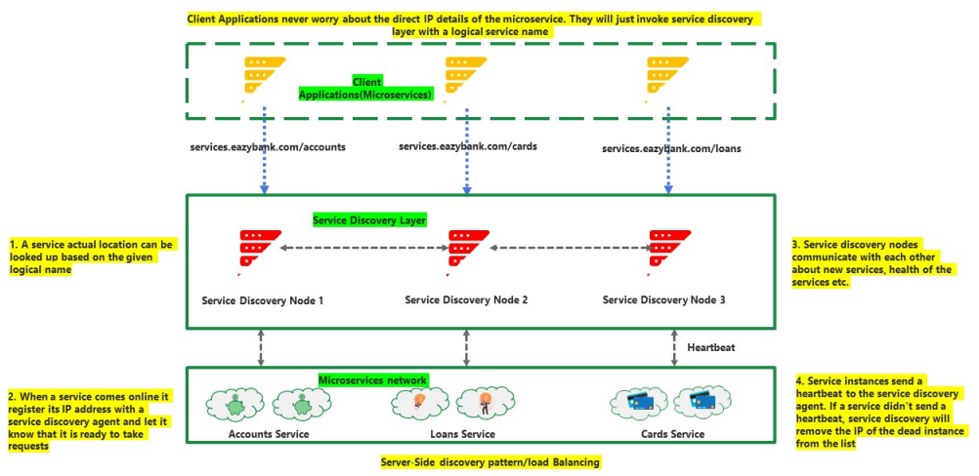

Slide 11
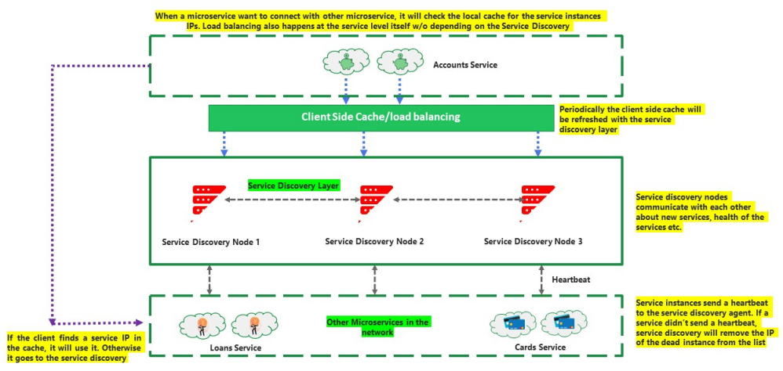

Slide 12
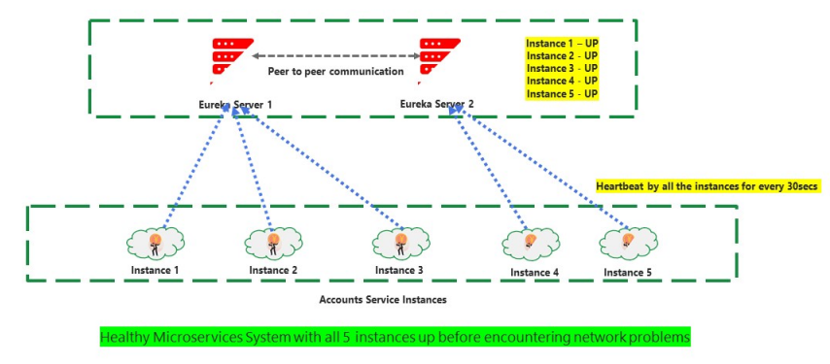

Slide 13
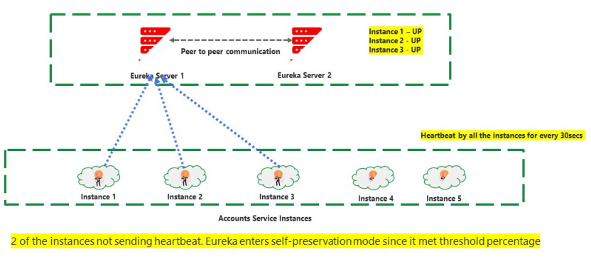

Slide 14
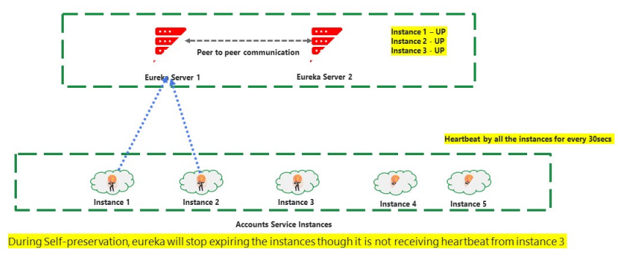

Slide 15
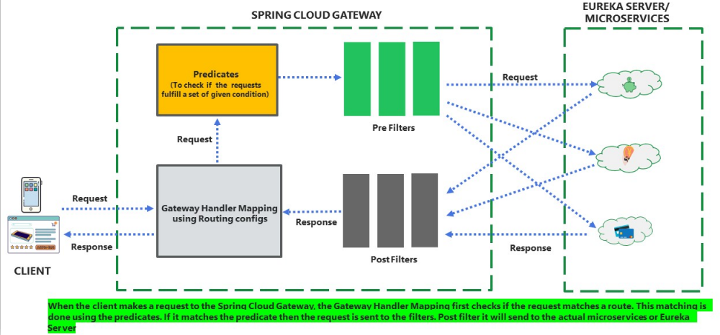

Slide 16
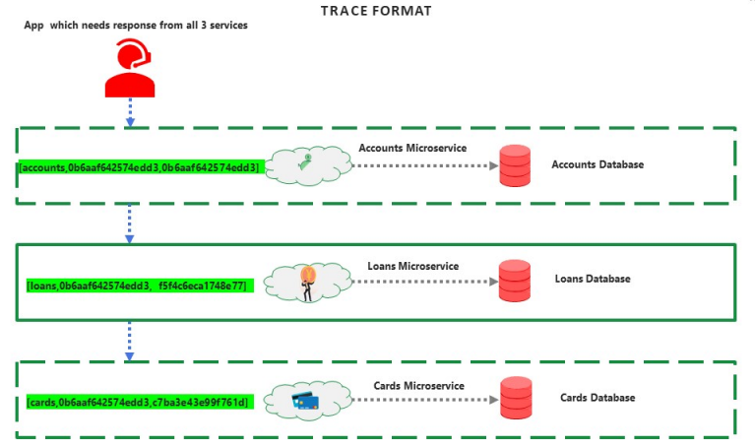

Slide 17
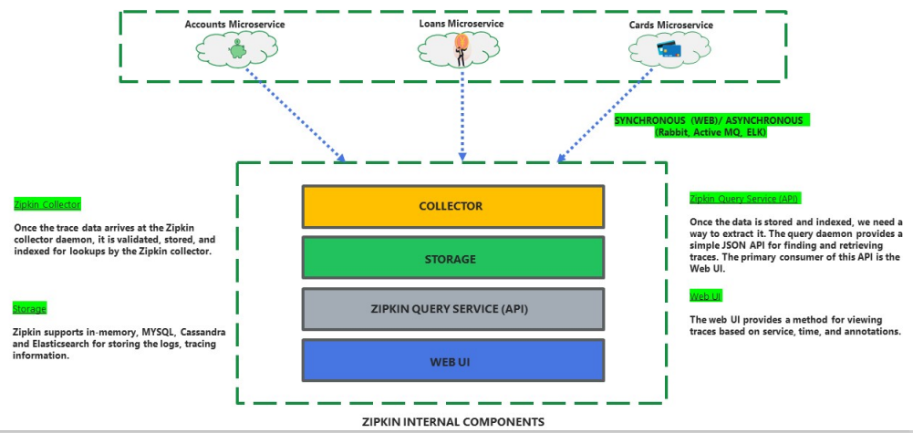

Slide 18

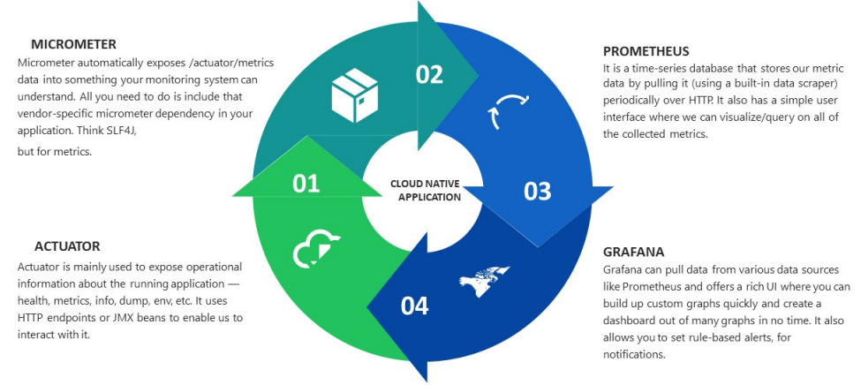

Slide 19

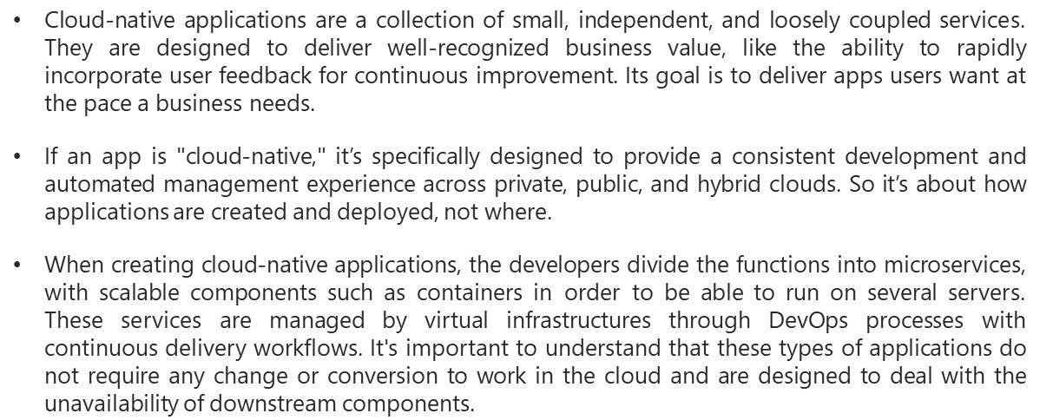

Slide 20
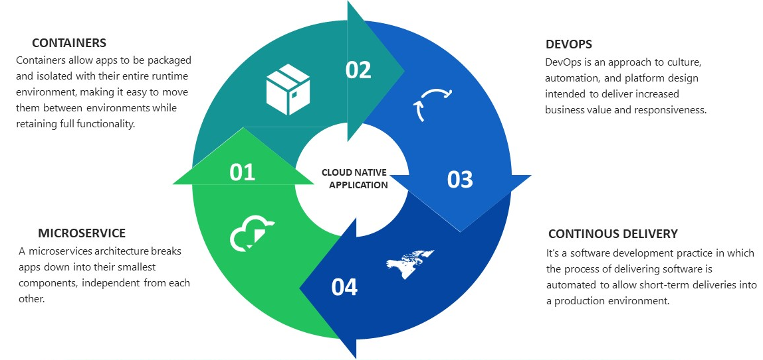

Slide 21

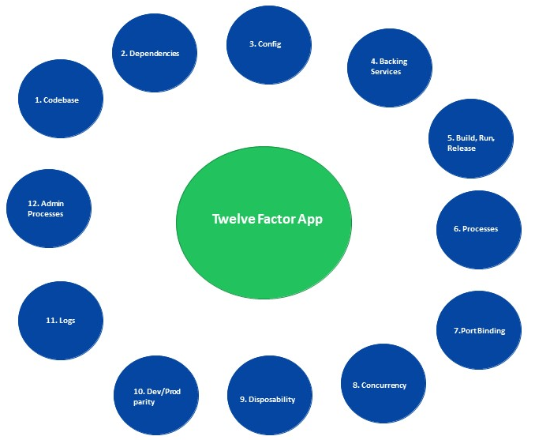

Slide 22

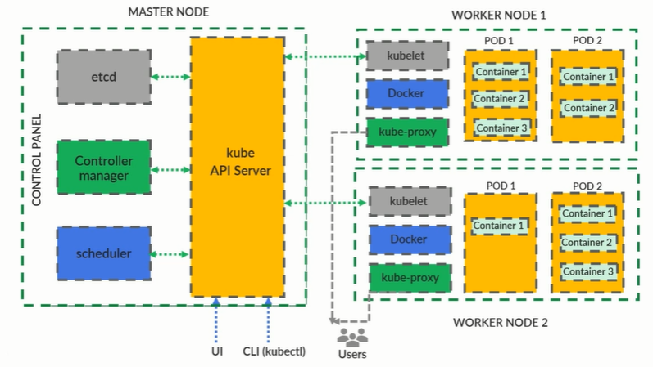

Slide 23
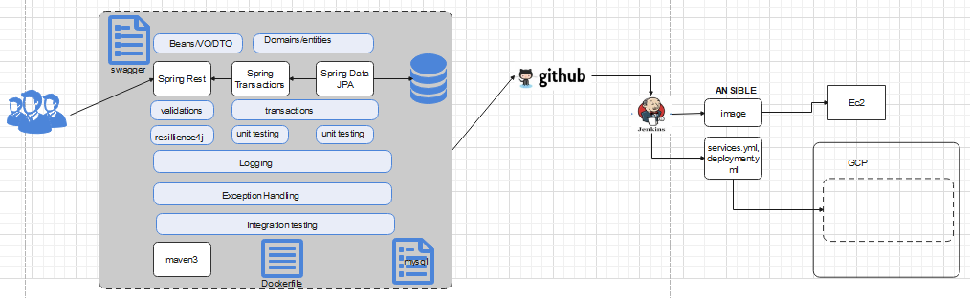
Implentation plan

Slide 24
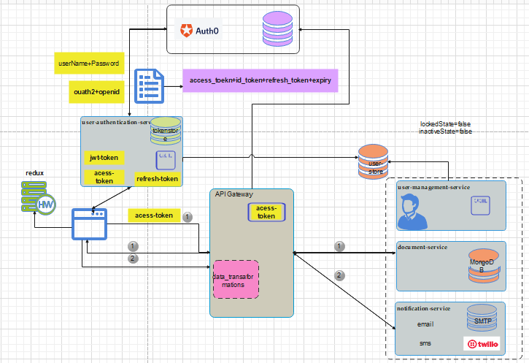

Slide 25
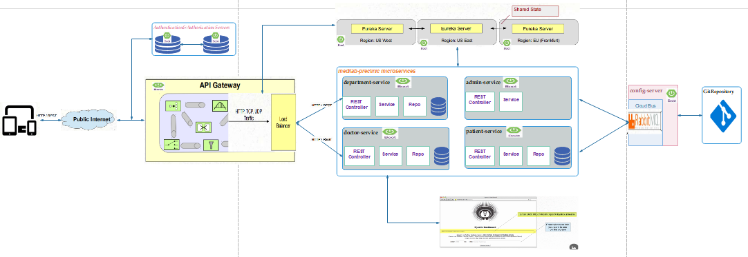

Slide 26
medilab-preclinic-core-services
Sr.no | Service | Type | Port
1. | user-management-service | medilab-core-service | 5001
2. | document-service | medilab-core-service
3. | user-authn-service | medilab-core-service
4. | department-service | medilab-core-service
5 | adress-service | medilab-core-service
6 | doctor-service | medilab-core-service
7 | doctro-schedule | medilab-core-service
8 | patient-service | medilab-core-service
9 | appointment-service | medilab-core-service
10 | payment-gateway-service | medilab-core-service
11 | Notification-Service | medilab-core-service

Slide 27
echo-system-components
Sr.no | Service/Setup | Type
1. | idp setup(Auth0) | medilab-echosytem
2 | git repo setup | medilab-echosytem
2. | Config-Server | medilab-echosytem
3. | Eureka with Cluster | medilab-echosytem
4. | Spingcloud-gateway with Security Constartins Validatio | medilab-echosytem
5 | Zipkin | medilab-echosystem
6 | ELK | medilab-echosytem
7 | Graphana/Promothesus | medilab-echosytem

Slide 28
Services:
Sr.no | Service/Setup | Type
1. | MySQL | docker image/RDBMS
2. | H2 | in memory/RDBMS
3. | mongo | docker image/NOSQL
4 | Keystone | docker image/Object Store
5 | S3 Storage | AWS Managed service Object Store
6 | Ngninx | docker image/WebServer
7 | RabbitMQ | Cloud Managed instace
8` | Twillio | Messaging Service
9 | gsmtp | Google Mail Server

Slide 29
Dev Infrastructure:
Sr.no | Infrastucture | Type
1. | Ec2(Ubuntu, 2Vcpu,2GB) | AWS Comute Service
2. | Application Load Balancer | AWS LB
3 | Docker | Container Engine
4 | Minikube/KubeAdmn | Kubernates Cluster
5 | Jenkins | CI/CD Orchestrator
6 | Ansible | Infrastructure Provisioner
7 | Fargate | AWS Managed Service
Prod Infrastructure:
Sr.no | Infrastucture | Type
1. | GKS | GCP Kubernates Cluster
2. | Ingress | LB/Reverse Proxy

Slide 30
Content-Agenda
Entities
===============
1) MedilabUser
2) Role
3) Permission
4) UserType
5) Address
6) Document
7) DocumentType
8) Notification
9) NotificationType
10) Token
11) MedilabAuthentication
12) Departmnent
13) Doctor
14) DoctorSchedule
15) Patient
16) Appointment
17) Payment

